Slide 1
The Art & Science
of the APPRAISAL
RANDY BARONE

Slide 2
Appraisals
Don’t let the title fool you. Appraisals are one of the most important areas in the dealership and make or break your new and used cars sales, crush your reputation, and overall dealership profitability.

Slide 3
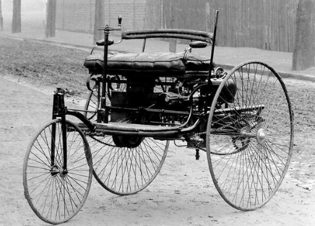
Appraisals
For as long as there have been vehicles there has been vehicle appraisals.
First Vehicle In The World The Benz MotorWagen

Slide 4
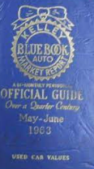
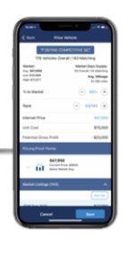
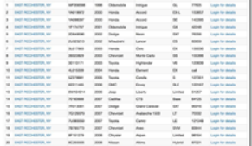
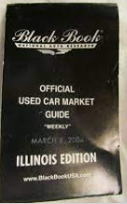
Appraisals
We have come along way from a person’s gut opinion, then to looking at a book, History, and then using a computer with a tremendous amount of data points.

Slide 5
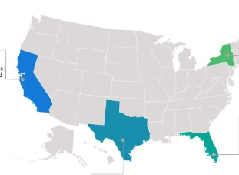
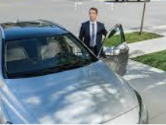
Appraisals
There is much more to appraisals than ever before because we now appraise trades at the dealership, trades in service, trades online, trades at peoples home and work, and even trades out of state,

Slide 6
Appraisals
Vehicle costs and complexities have made appraisals harder than they have ever been. Missing damage or flaws can massively affect your cost to market and ruin your opportunity for profit.

Slide 7
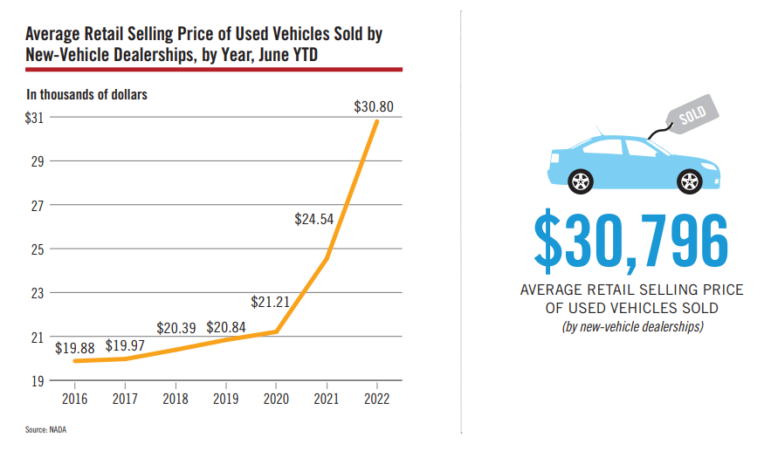

Slide 8
Appraisals
Just 10 years ago compared today’s vehicles
Vehicles went from 2 airbags to some more than 10
Some had navigation now many vehicles come with touch screen nav
collision warning systems
blind spot recognition
Front and back alert sensors
Automated braking
Parallel park themselves
Adaptive cruise control/Lane warning systems, Self driving
Windshield's went from $79 installed to $1000s
Headlights went from being $100 to $1000s
The list goes on and on ……………………………………….

Slide 9
Appraisals
Appraisers
Who trains them?
On going training?
Spending time in the shop
Estimated Recon vs. Real Recon
Wholesale/Retail Profit by Appraiser

Slide 10
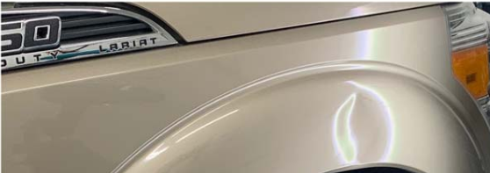
Appraisals
$100 PDR repair
What does it cost to fix this?

Slide 11
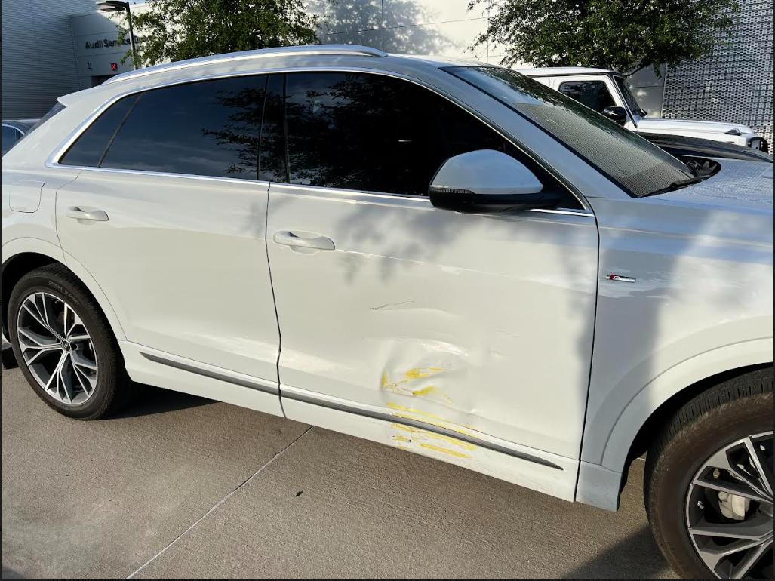
Appraisals
$4350 Dealership Bodyshop
What does it cost to fix this?

Slide 12
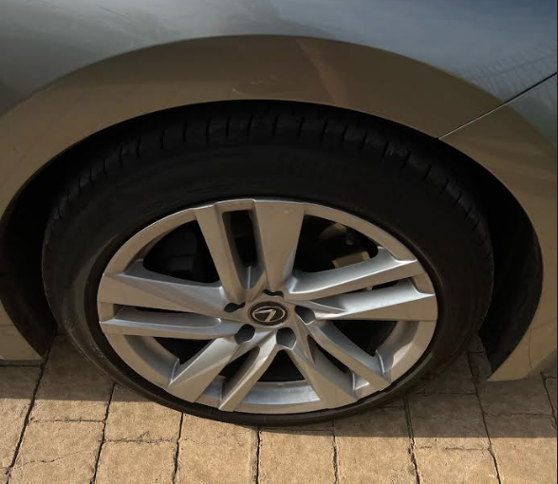
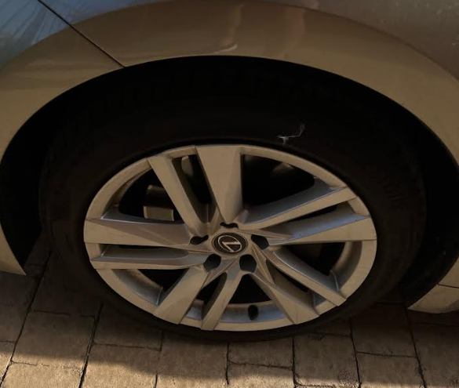
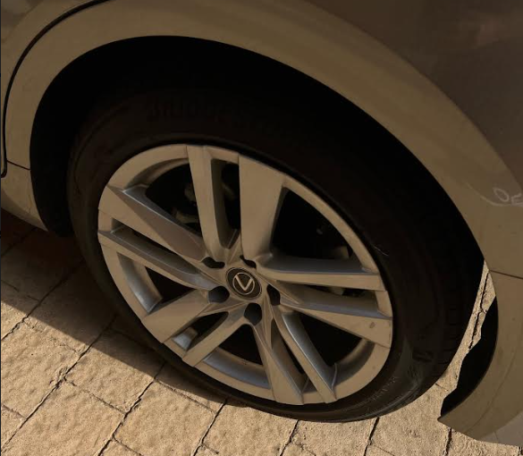
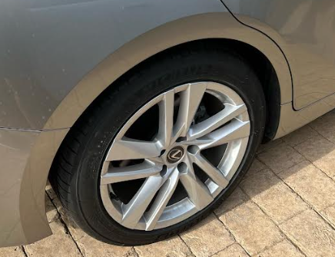
Appraisals
What does it cost to fix this?
A mismatched tire?
Certified vehicle with wrong tire size or speed rating?

Slide 13
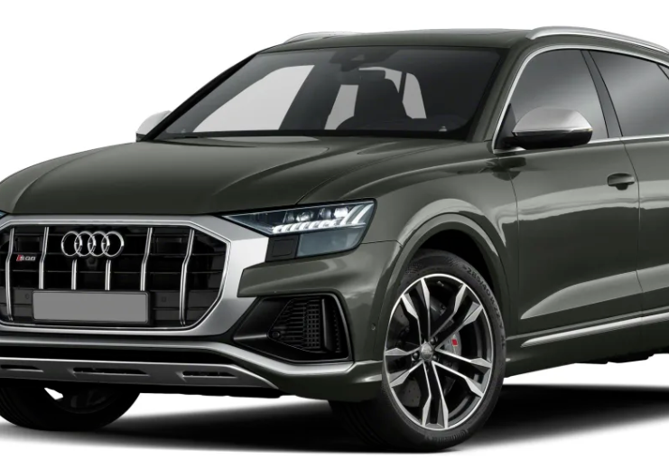
Appraisals
What does it cost to fix this?
Then the car had to go Audi dealership service department in order to “complete some alignments and adjustments that need to be done that interphase new windshield with the car’s “”systems””
SQ8--Local Audi dealer partners with a windshield company for the install (OEM replacement) and then Audi "calibrated safety systems" Total cost was about $2,500
6in. crack in glass
Non-OEM Glass

Slide 14
Certified Vehicles

Slide 15
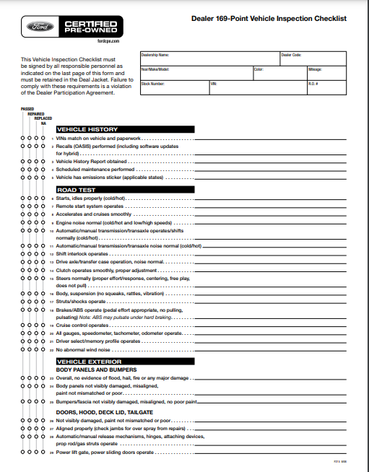

Slide 16
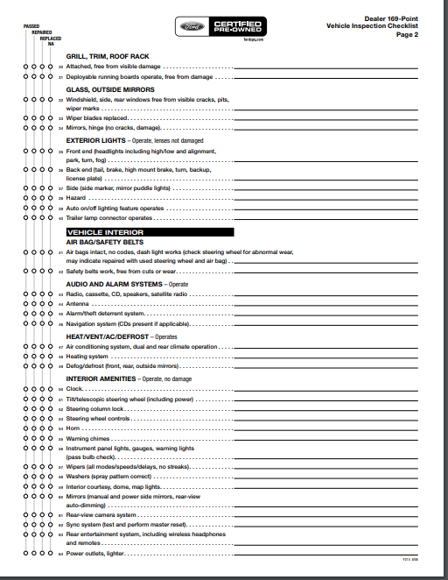

Slide 17
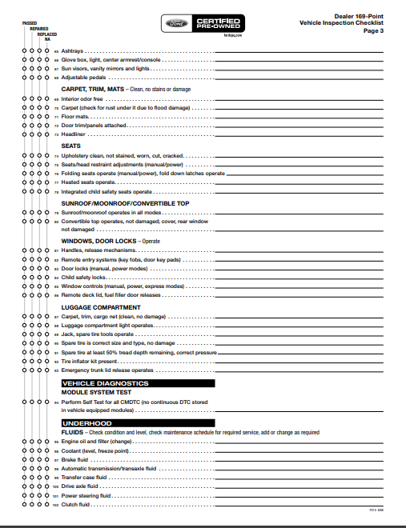

Slide 18
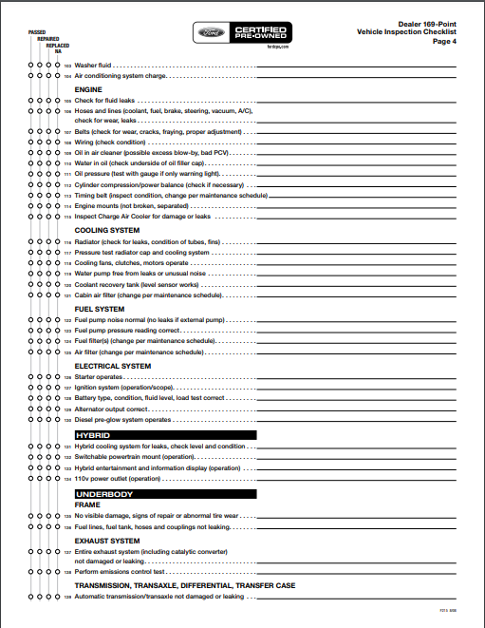

Slide 19
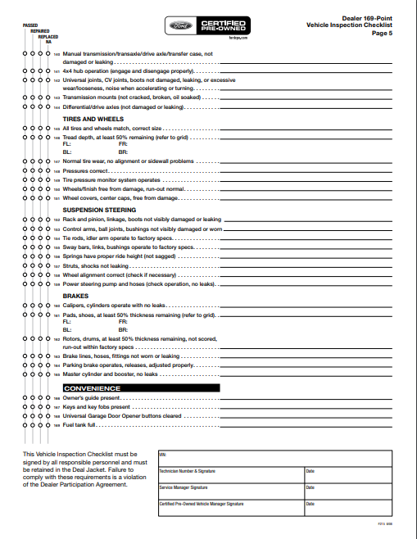

Slide 20
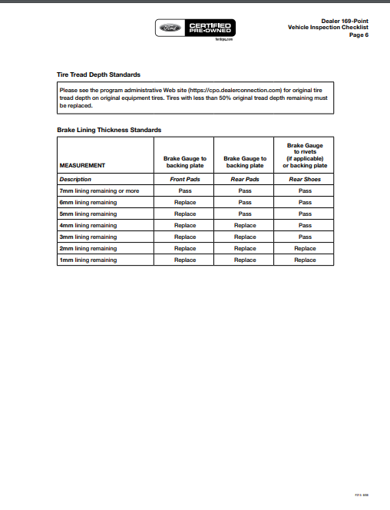

Slide 21
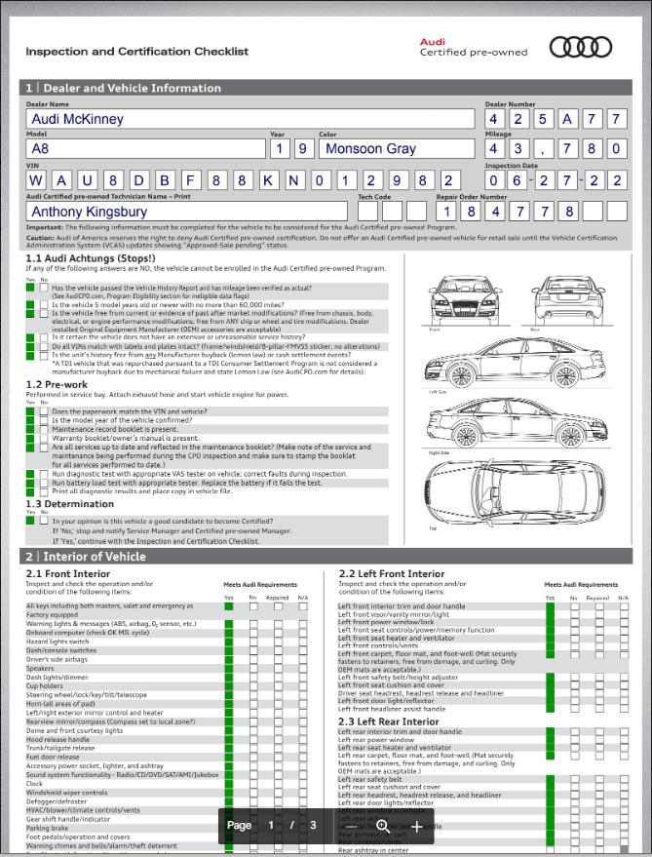

Slide 22
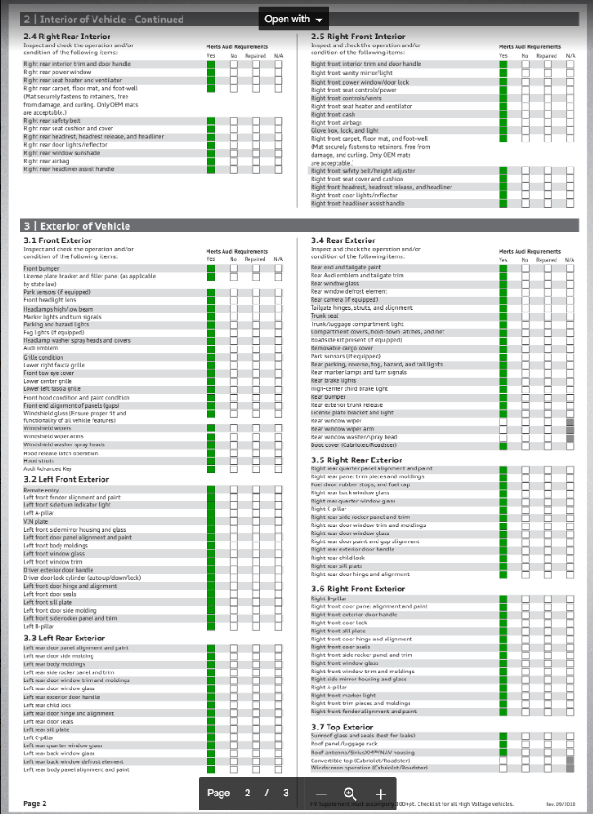

Slide 23
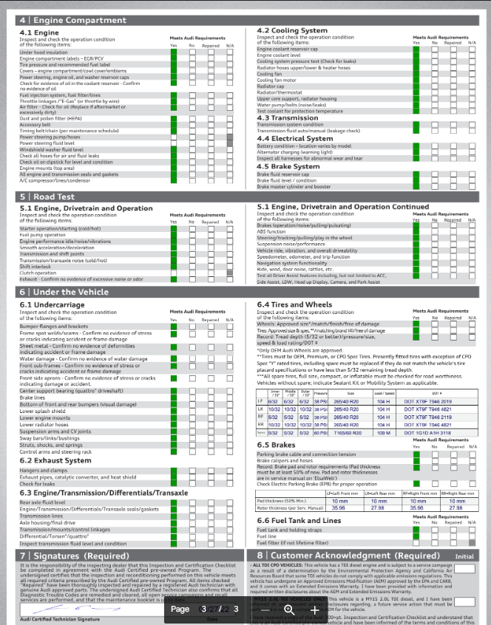

Slide 24
Appraisals
Manager
Try to have key personnel on decisions at all times
Attitude towards appraisals
Inspect vehicle or have it inspected
Appraisal based on needs
Group Knowledge- Same Brand
Group needs
Stay in your lane
Carfax/Autocheck

Slide 25
Appraisals
Manager
Wholesale trending data
Short and Hot Data
Paint meter
Set a timer
Presale if legal
Picture
Fully describe damage

Slide 26
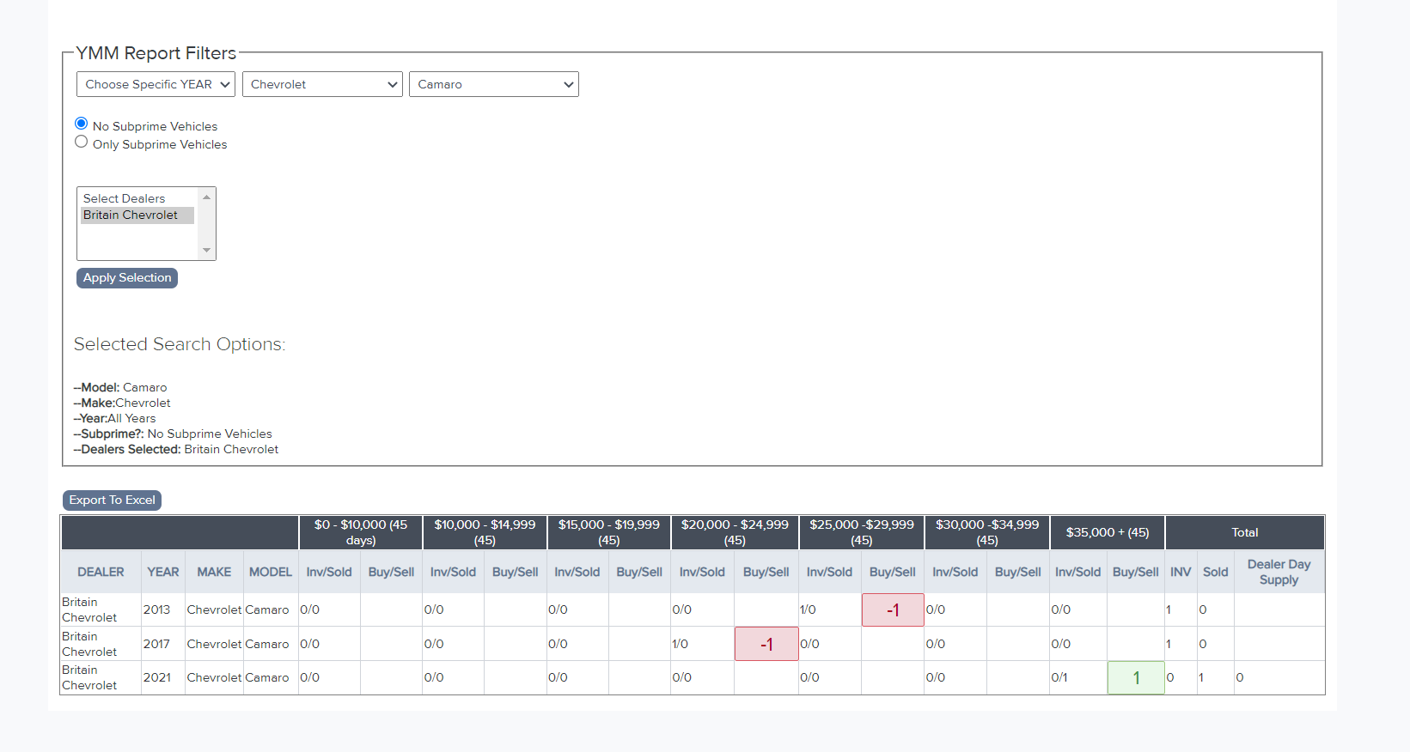

Slide 27
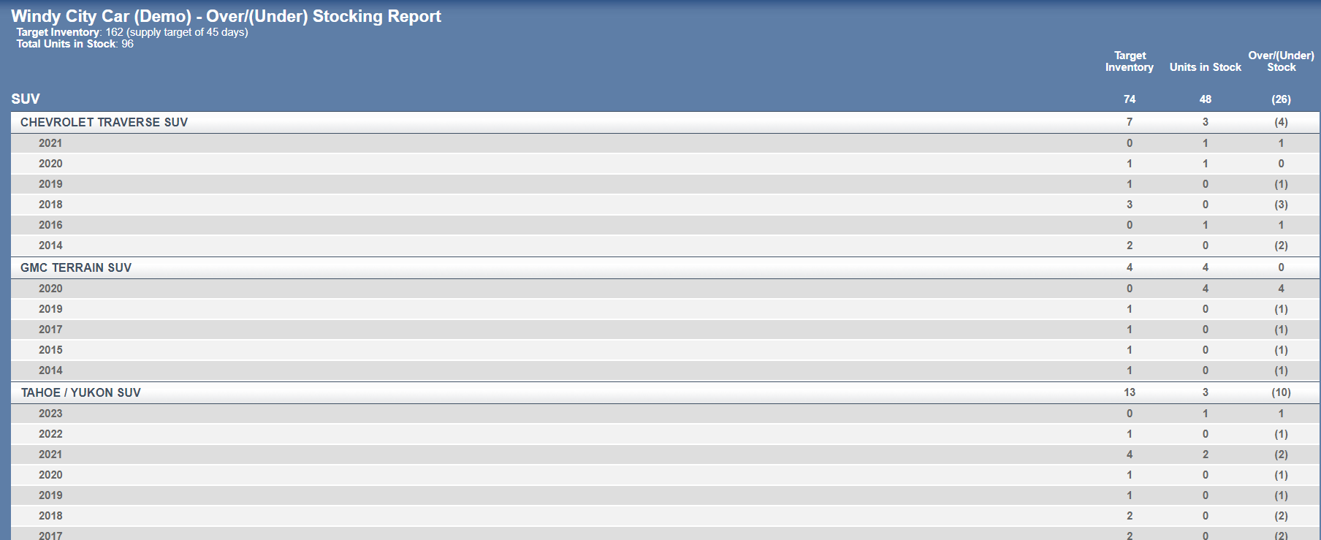
Appraisals

Slide 28
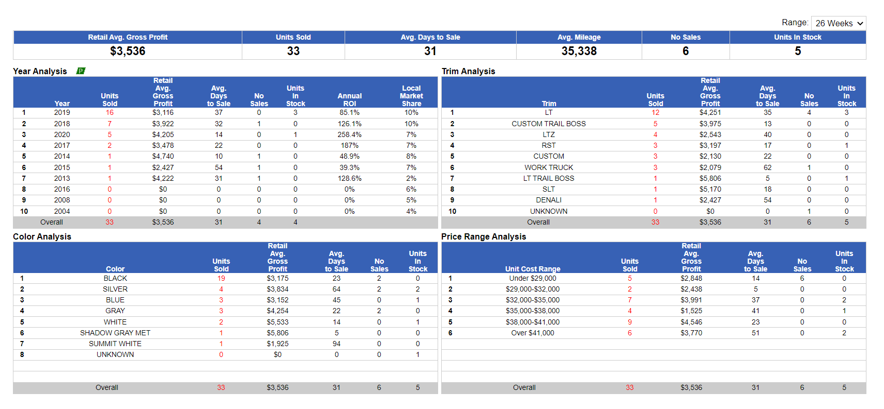
STOCKING BASED ON FACTS

Slide 29
STOCKING BASED ON MARKET

Slide 30
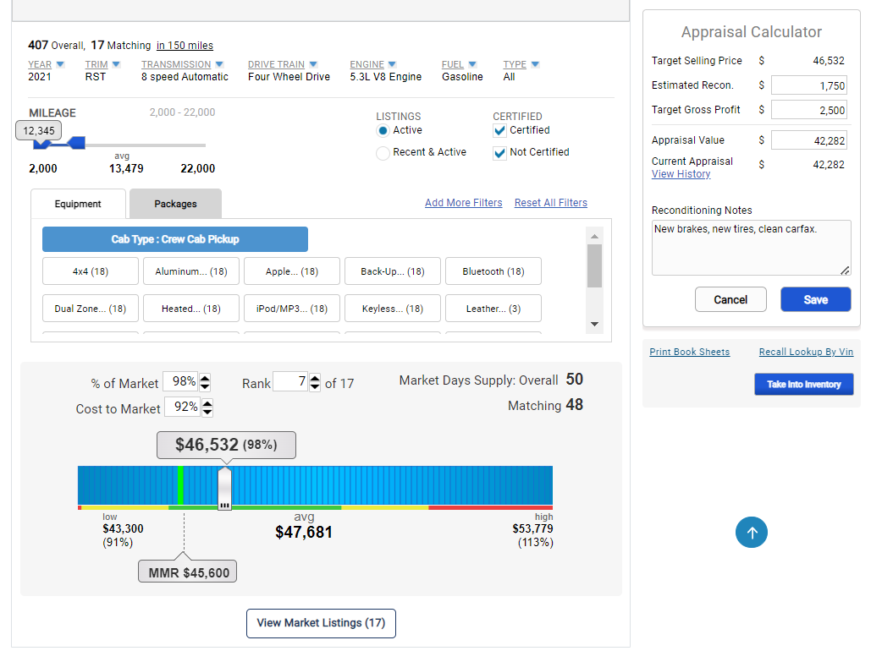

Slide 31
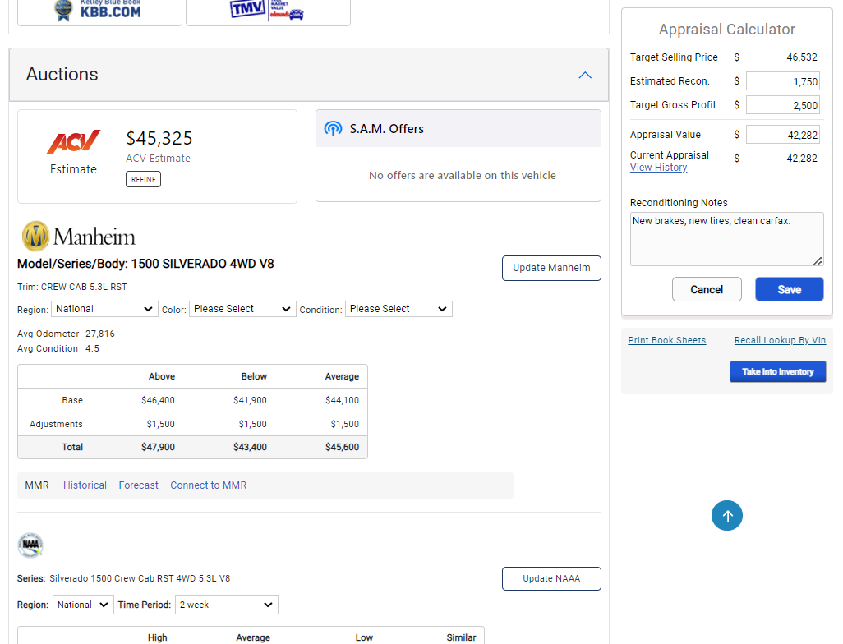

Slide 32
Appraisals

Slide 33
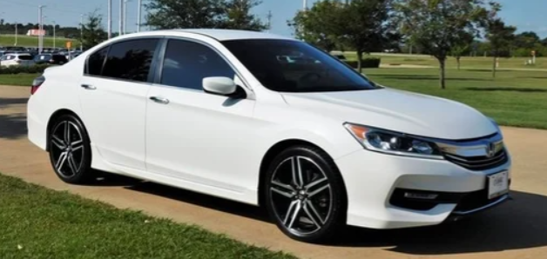
REAL LIFE SCENERIO
Customer searching for a 2017 Honda Accord on the web and finds yours
Customer pulls Carfax and see that the vehicle has an accident reported

Slide 34
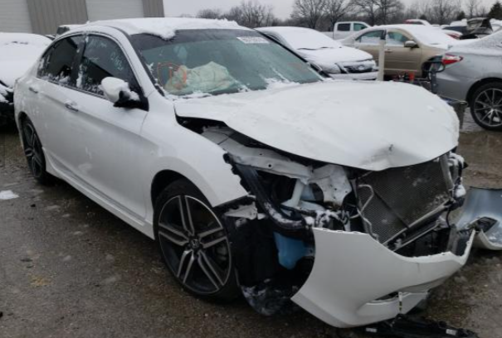
WHAT THE CUSTOMER IMAGINES

Slide 35
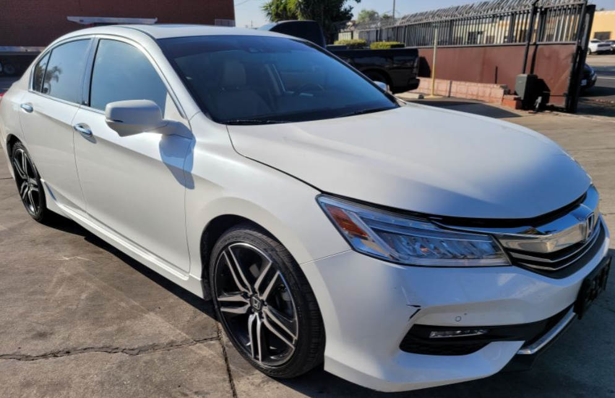
THE REALITY
Cosmetic Damage: A minor collision resulted in a pushed in grill and scuffed bumper.

Slide 36
PERCEPTION vs. REALITY
Both Vehicles Show Accident Reported to Carfax
A True360 Inspection report uploaded to the Carfax and available on the web link makes them very different

Slide 37
Neutralize Accident History
We’re the company that created the True360 Inspection. The Report was developed to help Dealerships retail all vehicles with confidence…
Both Carfax and AutoCheck trust the True360 Report as the true condition of the vehicle.

Slide 38
Your Car,
Your History
We Take the Mystery Out of the History.
72% of all vehicles inspected with accident history have only sustained minor cosmetic repairs
After a True360 inspection is completed, “inspection found very minor damage repairs” often populates the 2nd line of the CarFax.
“Accident reported” is very vague to the consumer and the extent of damage from the accident is unknown.
All qualified vehicles receive our LiveLink to the True360 report.

Slide 39
Appraisals
Top Missed Items on an appraisal
Dashboard lights (Check engine, others)
Drivability issues
Missed damage (lower body damage, Tire wear, wheel damage, Paint)
Underestimated damage
Missing remotes (broke remotes)
A/C or heater issues
Interior (cracks in dash or console, PW, PL, Pseats, Sroof, Screens, and Audio)
Electrical issues

Slide 40
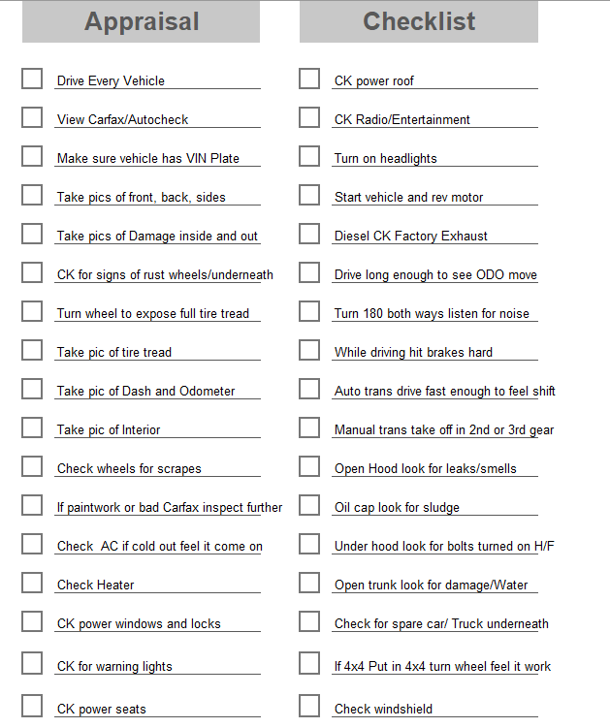
Appraisals

Slide 41
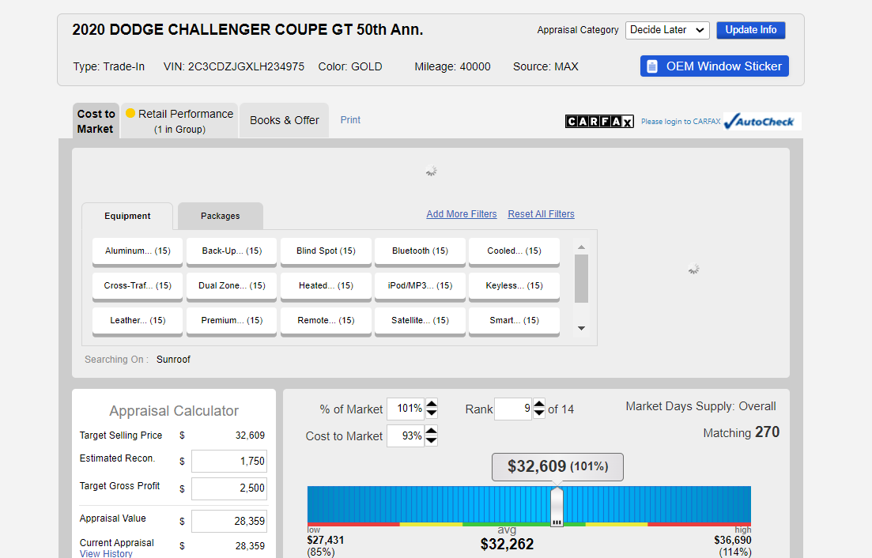
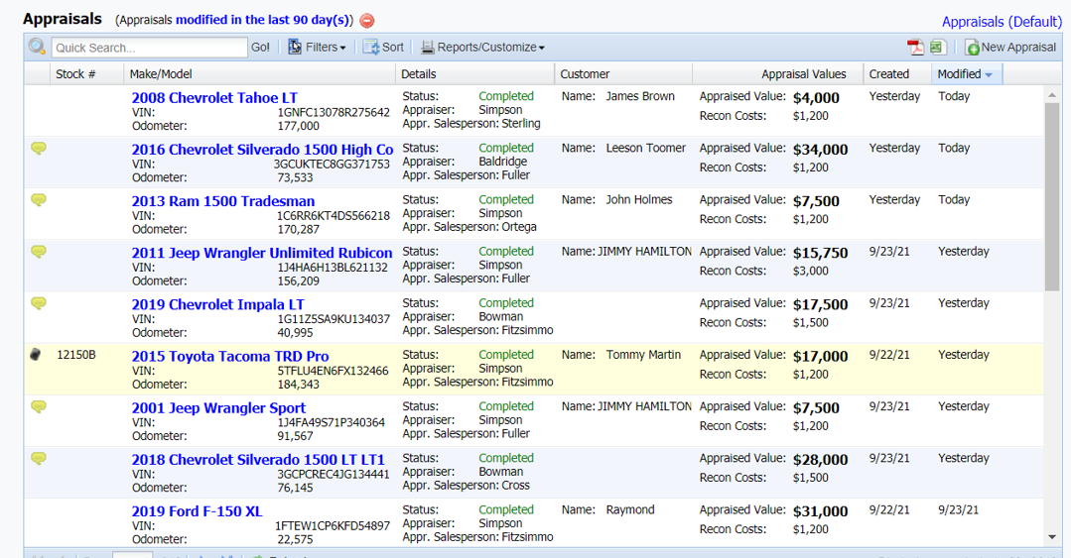
Appraisals
Current Appraisal Tools

Slide 42
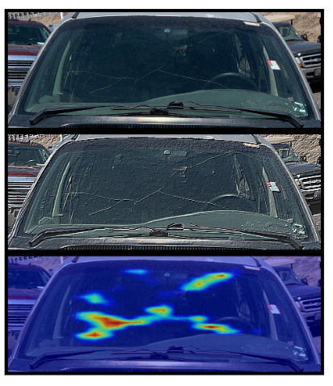
Appraisals
Future Appraisal Tools

Slide 43
Appraisals
Future Appraisal Tools

Slide 44
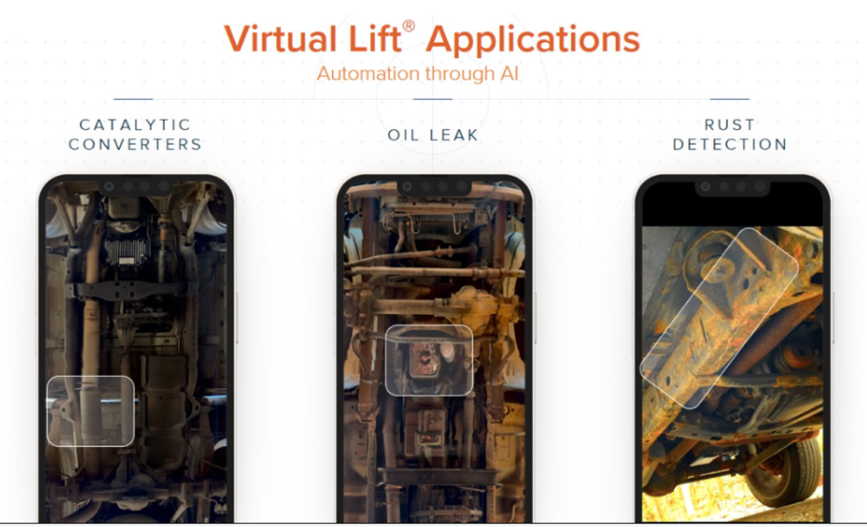
Appraisals
Future Appraisal Tools

Slide 45
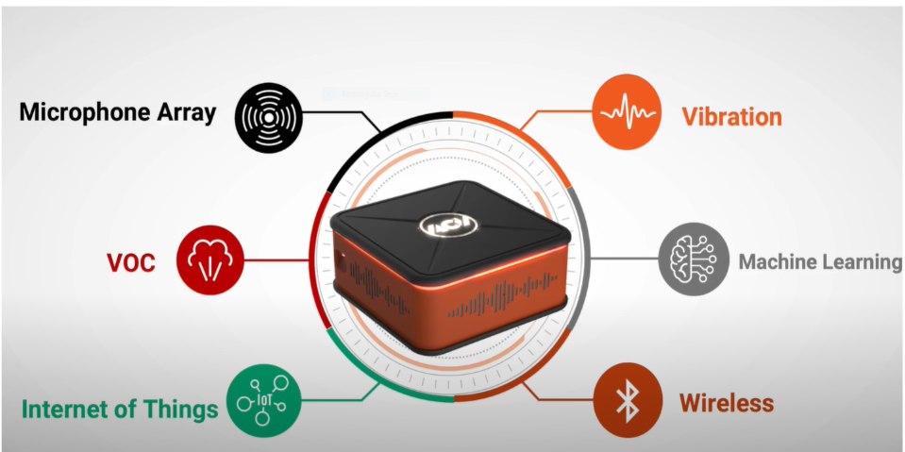
Appraisals
Future Appraisal Tools

Slide 46
Appraisals
Salesperson's role in appraisals
Silent walk around
Help sell the new or newer vehicle
Support F&I
Deal support (cash down, deal structure)

Slide 47
Appraisals
Trouble with over appraising
Typically happens when using the wrong source, Not aware of incentives or packages, limited experience with certain brand, ran over by new car department. Causes high wholesale, high cost to market, lower opportunity for profit,and potential wholesale loss
Trouble with under appraising
Typically happens when using the wrong sources, limited experience with certain brand, poor last experience, by design trying to steal a trade, aged inventory, poor wholesale losses. Causes low trade ratio, poor customer retention, poor new and used car sales, salesperson turnover, increase in auction purchases.
*Over And Under Alerts

Slide 48
Appraisals
Trade in closing ratio or Look to book
Single most important number to know
Low- killing sales both new and used, killing sources of inventory, killing customer retention, Killing salesperson retention, causes high auction purchases
High- Make sure to keep an eye on wholesale losses, aging, cost to market
Most important!! Know your number and know it is accurate

Slide 49
Appraisals
Trade in closing ratio or Look to book-Salesperson
IMS tools like Vauto, ACV/Max, and others have appraisal closing ratios broke down by salespeople
Address salespeople with low number of appraisals
Address salespeople with low closing ratios, or low look to book
Train, role play, and have one on one training on trading for a vehicle

Slide 50
Appraisals
Lost ART of the silent walk around/Trade evaluation
Process should be part of every deal
Dealership agreed process
Have questions that are required when there is a trade
Have questions when there is no trade offered
Have technology help hold this process in place
If dealership group, then process consistent at every location

Slide 53
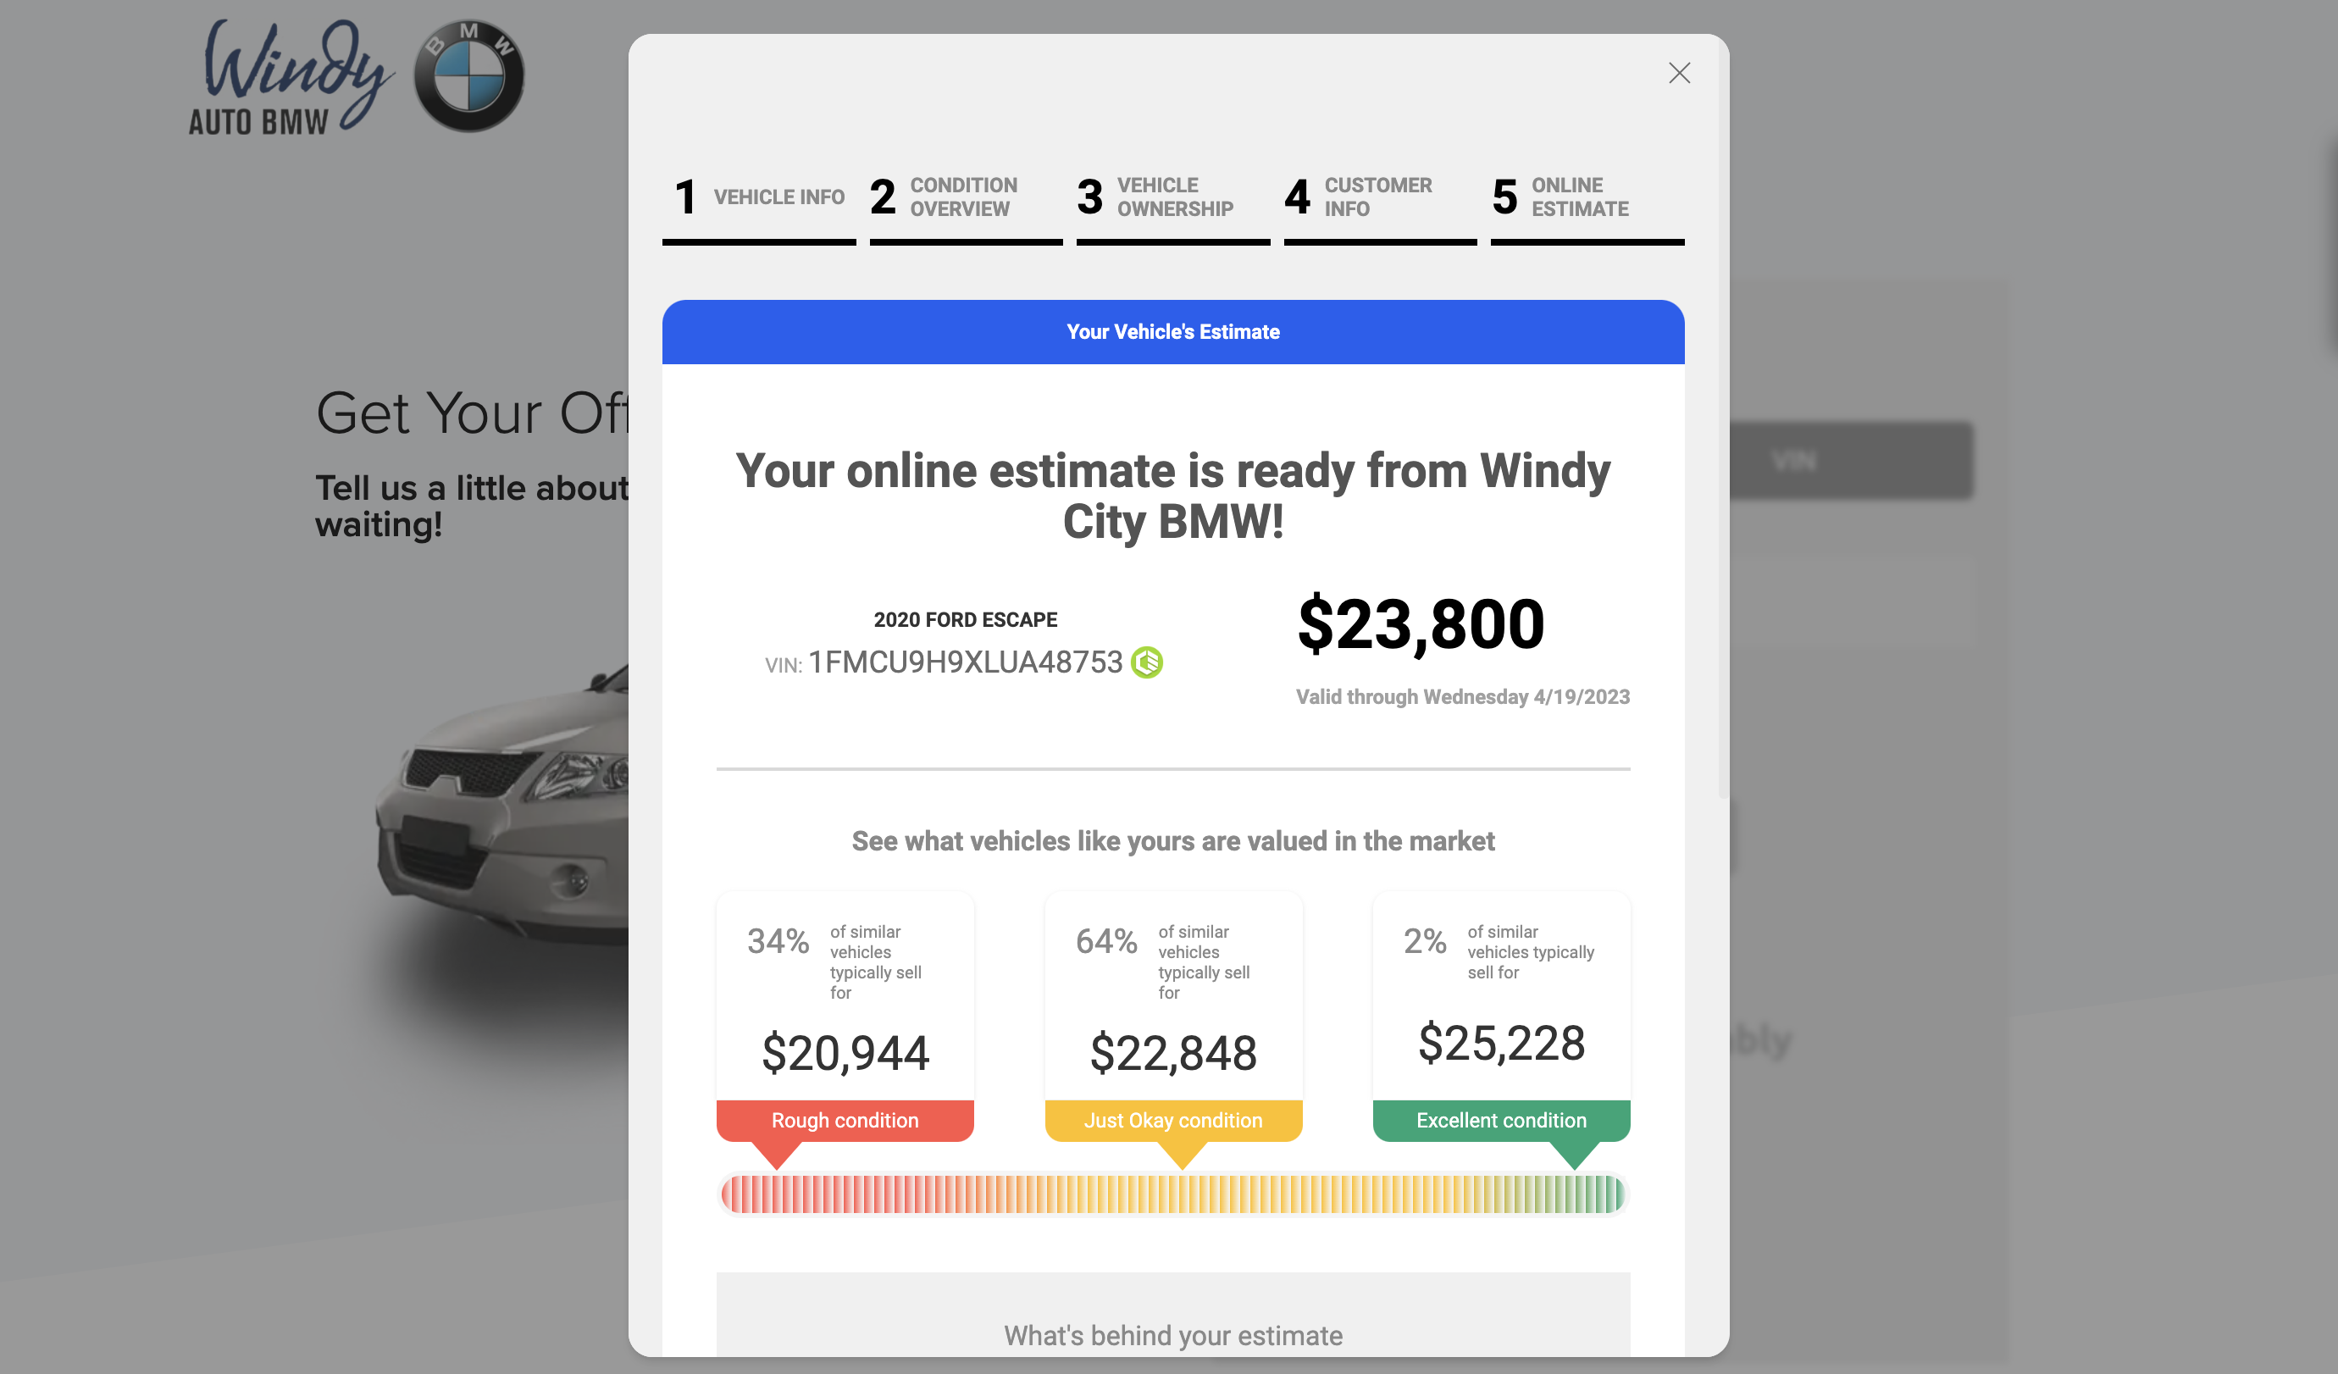

Slide 54
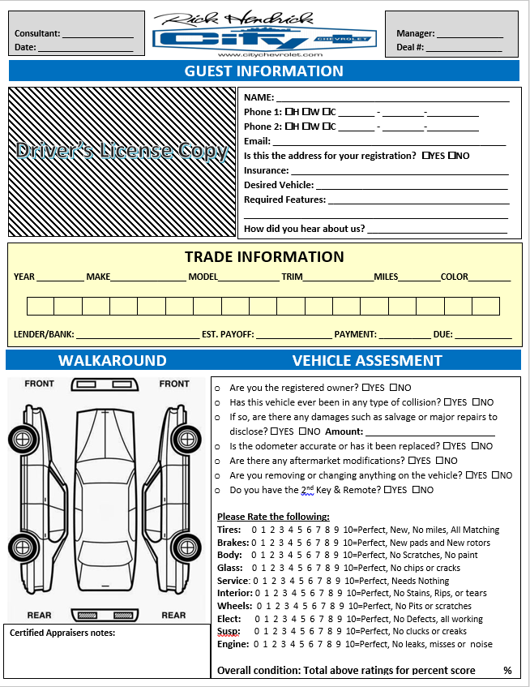
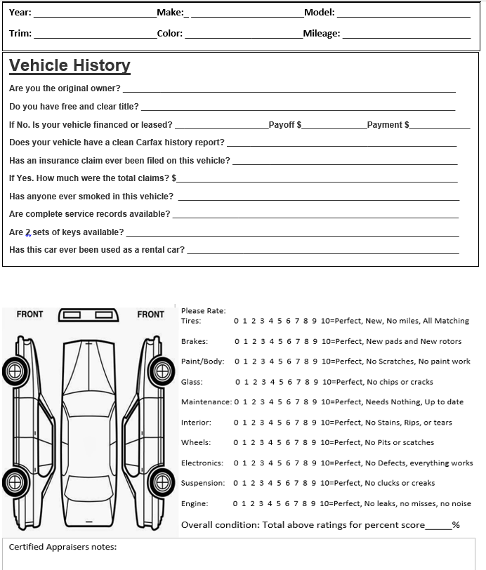
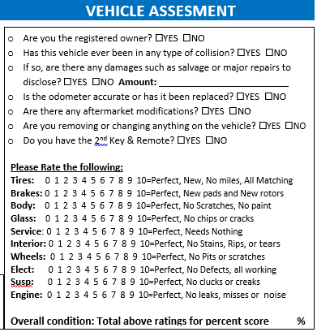
Customizable Questions – Engaging the Client in the Process

Slide 55
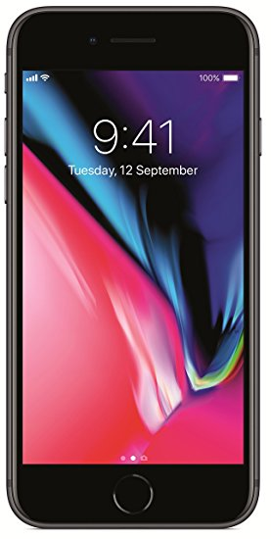
MAX My trade
Search “MAX My Trade - MAX Digital”
Names & email address required to create user ID*
OR
OR
iPad
iPhone
Android Tablet
Android Phone
iOs 11.3 or higher required
Android 4.1 or higher required

Slide 56
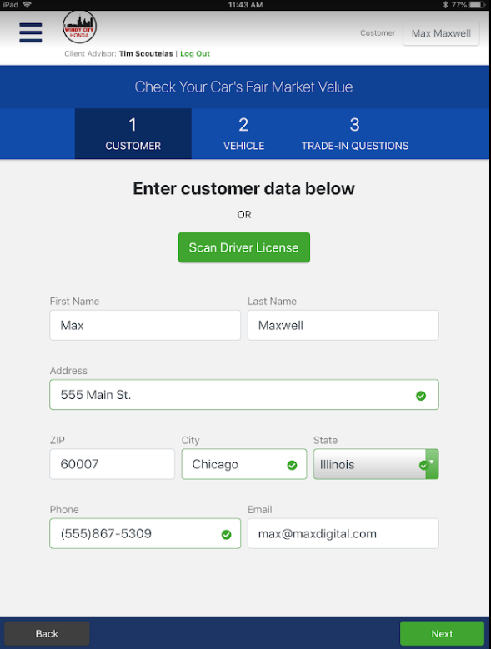
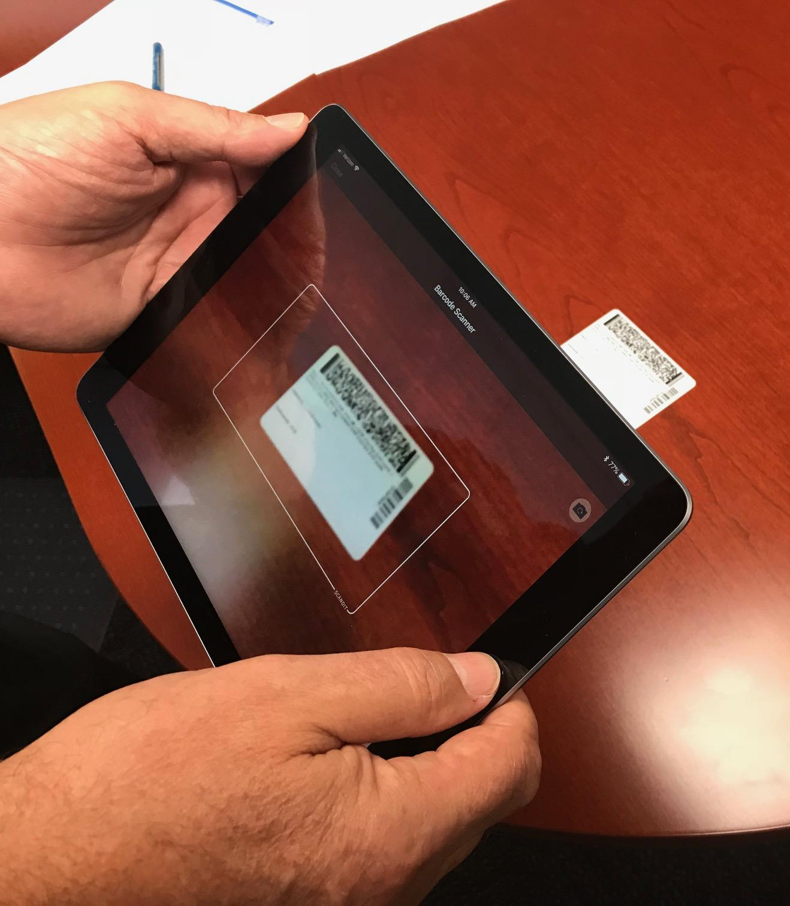
Collect Customer Data
Scan The Back of DL

Slide 57
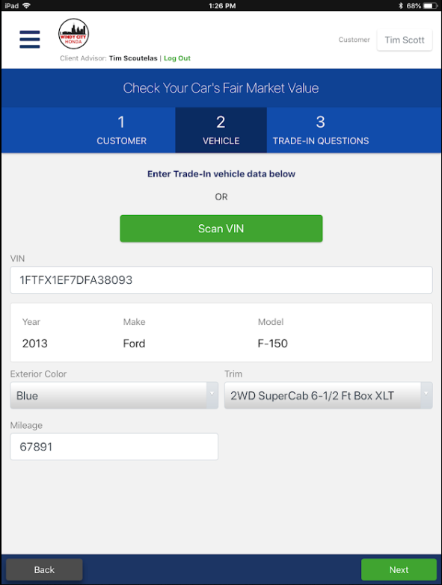
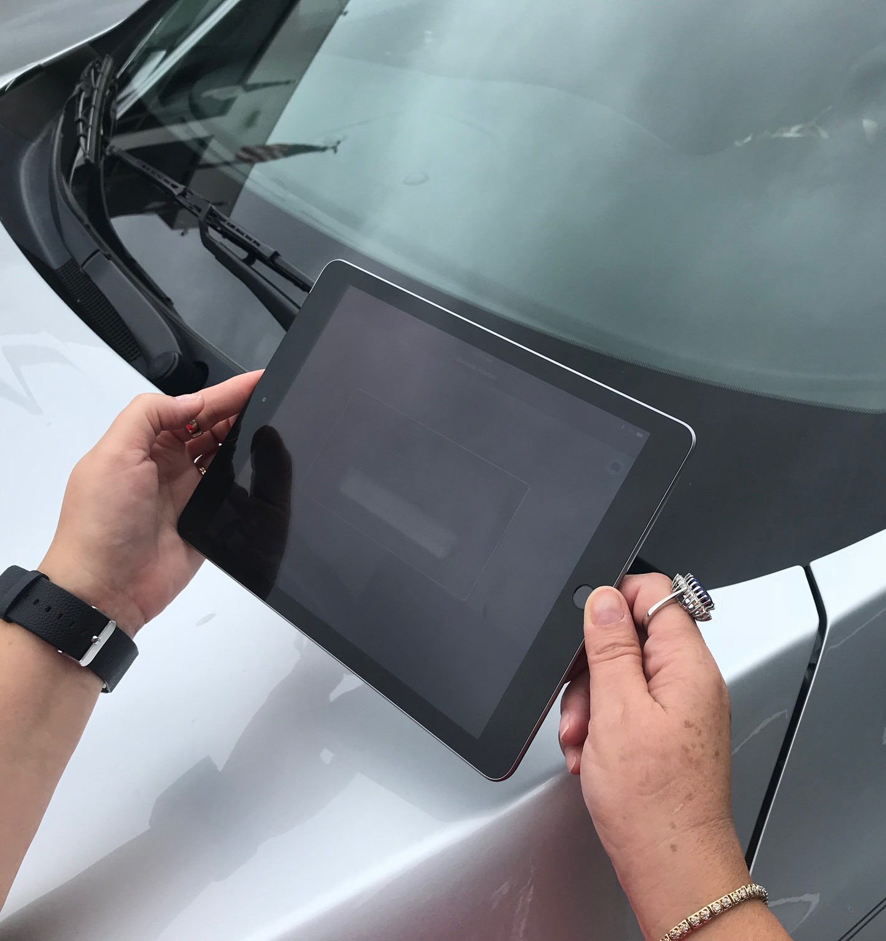
Collect Vehicle Data
Collect Vehicle Data

Slide 58
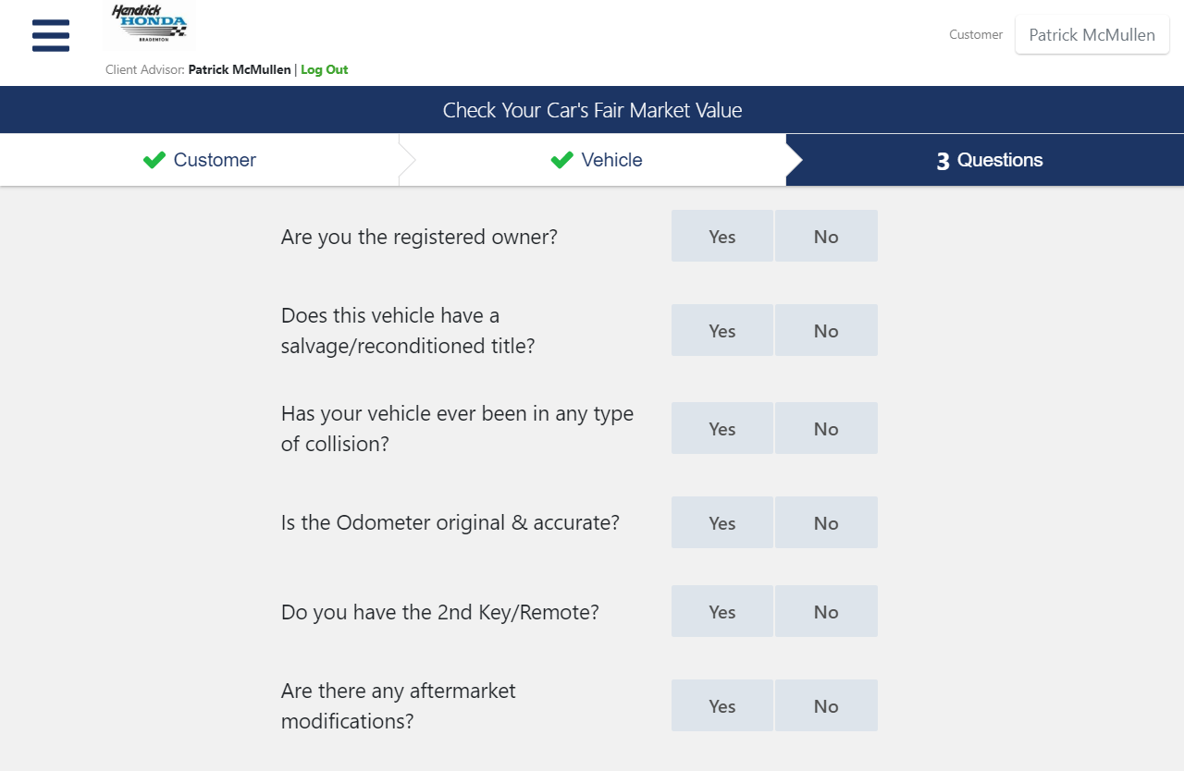
Trade-In Questions

Slide 59
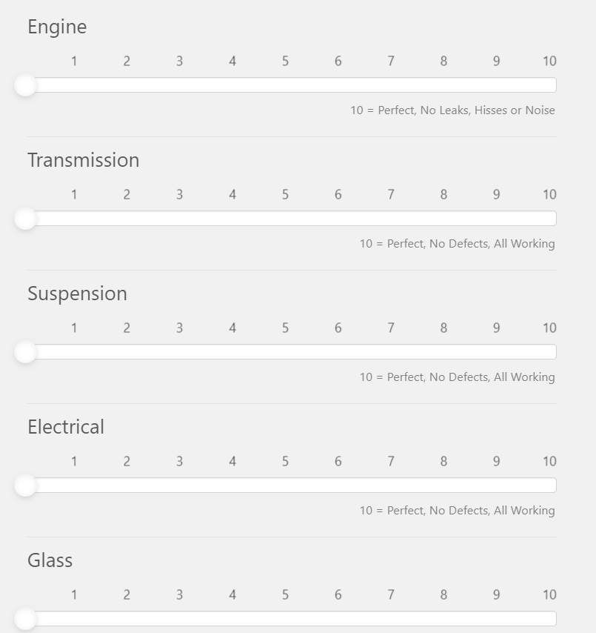
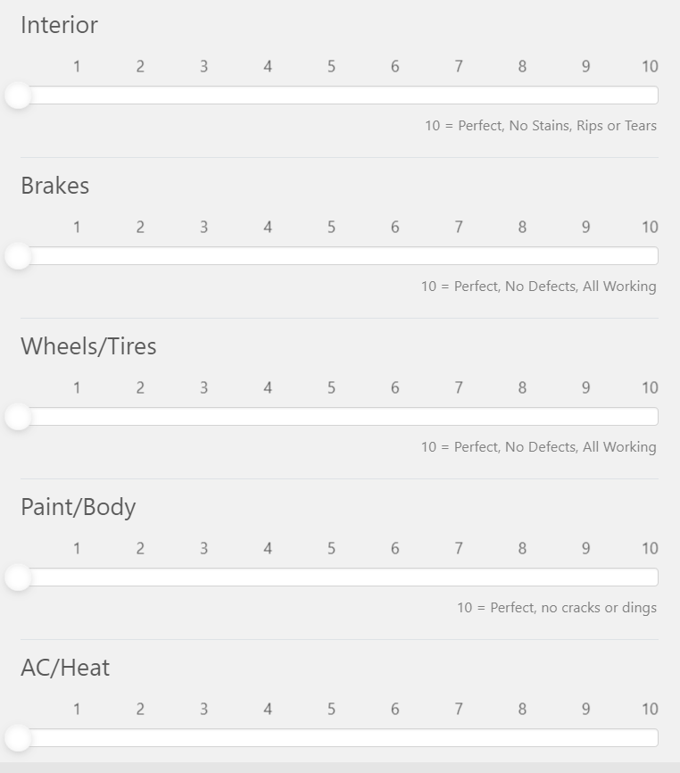

Slide 61
Appraisals
Pros and Cons of holding on trades
Gambling comparison- wins vs. losses
Pros-Increased opportunity for gross-Short term, helps with consumers wanting bigger discounts, helps margin wholesale losses
Cons-Causes poor trade closing ratios, hurts customer retention, hurts inventory acquisition, cause increase in auction purchases, hurts new and used car sales, causes salesperson turnover, and hurts reputation.

Slide 62
Dealer A appraises 10 vehicles and trades for 6
From the 6 trades 4 were on new cars and 2 were on used vehicles
4 new cars avg $2K Front and back totalling $8k
2 used cars avg $3k Front and back totalling $6k
From the 6 trades 4 were kept for inventory and 2 were wholesaled
The 4 retail vehicles avg $3k=$12k
The 2 wholesaled avg $300=$600
2 trades were taken in on the 4 retail deals
1 retailed $3k
1 wholesaled $300
$29900 Net

Slide 63
Dealer B appraises 10 vehicles and trades for 3
From the 3 trades 2 were on new cars and 1 were on used vehicles
2 new cars avg $3K Front and back totalling $6k
1 used cars avg $4k Front and back totalling $4k
From the 3 trades 2 were kept for inventory and 1 were wholesaled
The 2 retail vehicles avg $3k=$6k
The 1 wholesaled avg $300=$300
trades were taken in on the 2 retail deals
1 retailed $3k
1 wholesaled $300
$19600 Net

Slide 65
Key Takeaways
Make sure you have the right APPRAISAL ATTITUDE across your team
Train your appraisers
Get presentations from all IMS systems and appraisal tools
Inspect your process
Make sure you have an appraisal walk process
Inspect appraisal closing ratio/Look to book managers
Inspect appraisal closing ratio/Look to book Salespeople
Setup over and under alerts
Have save a Trade meetings
Inspect lost trade report

Slide 66
Q & A
For a more personalized discussion & additional ideas, please contact us for a free consultation.
Randy Barone rbarone@acvauctions.com
Mobile- 832-794-0118

